Slide 1
What Can Health Analytics
Do for Us?
david.sgorbati@nhs.net
https://healtheconomicsunit.nhs.uk/

Slide 2
Hello, My Name Is David
I work at the Health Economics Unit
Part of Midlands and Lancashire CSU
Data scientists, data engineers, and health economists
Work with NHS, academia, and commercial sector
I’m David
I’m a computer scientist
Start-up and NHS experience
I love my job

Slide 3
Why Do We Do What We Do?
Health is complicated!
We make large volumes of decisions every day:
Should this patient be prescribed statins?
Should we build a new hospital in Devon?
How much should we spend on depression treatment?
How many occupational therapists should we hire for a 20-beds stroke rehabilitation ward?
Health analytics aims to improve decision quality

Slide 4
We Sail Vast Seas of Data
We have access to many aggregate datasets: QOF, ONS, MHSDS…
Sometimes, we even have access to many patient-level datasets: HES, MHSDS, PLICS…
And many platforms help us bringing them together: Fingertips, CPRD, WSIC, HeI…
And we are not yet using extensively wider determinants datasets!

Slide 5
But No Dataset Is Straightforward
The reason behind the establishment of a dataset shapes the data
The interpretation of the reason for collection by the data collector will have an impact
Context, including time pressures, culture, and measuring tools, might also warp what is recorded
Any additional processing could be difficult to disentangle
Also, data don’t necessarily “say” much without analysis

Slide 6
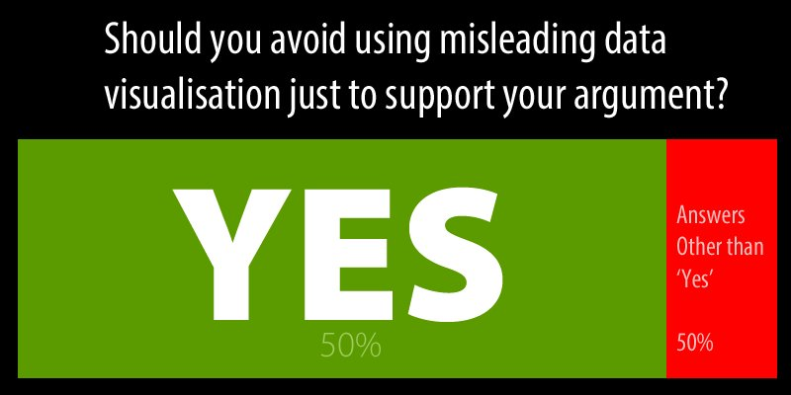
Lies, Targets and Statistics
We are good at setting targets – not always great at predicting how those will have an impact on culture and behaviours
We sometimes rely on summary statistics – but that’s not always helpful

Slide 7
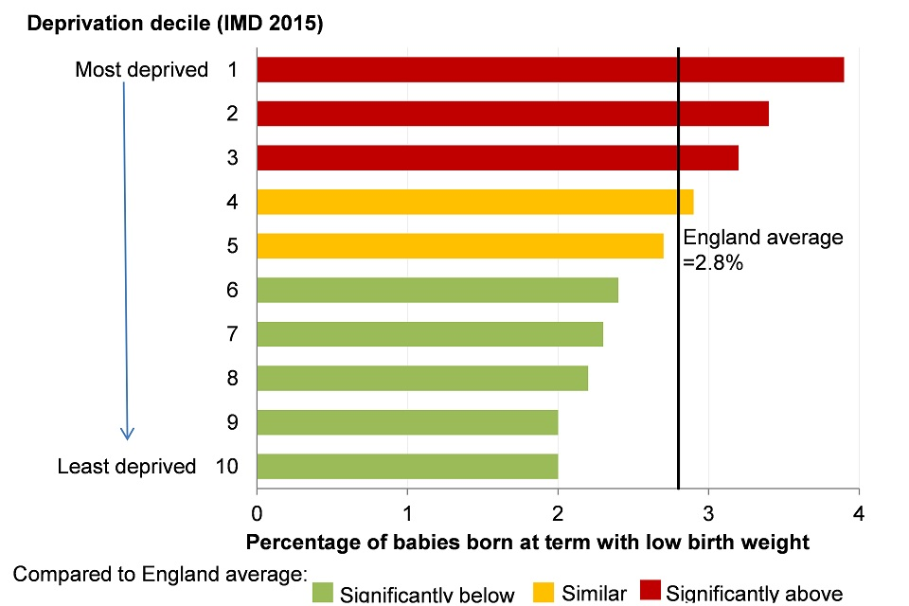
Example: Deprivation
Deprivation is routinely discussed as a factor in poor health outcomes
Summary statistics and predictive modelling will consistently show how people living in the most deprived areas are more likely to be ill and die earlier than people living in the most affluent areas
But is this helpful?

Slide 8
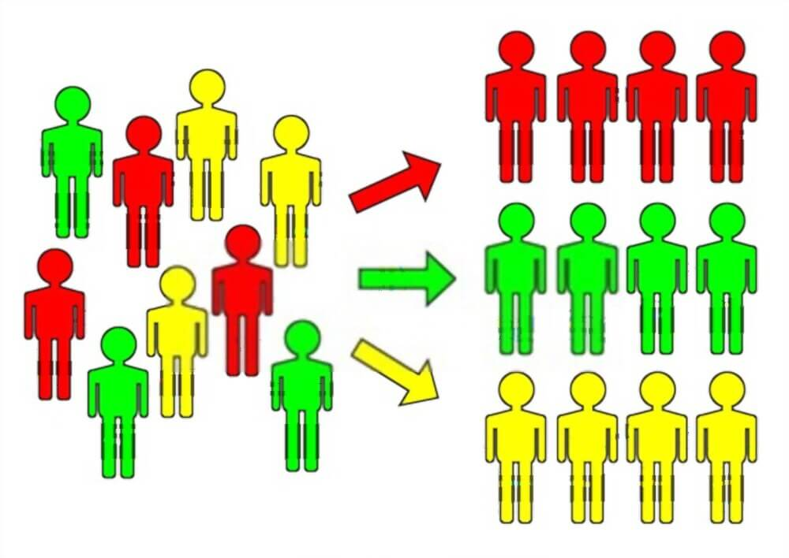
Example Technique: Population Segmentation
Health metrics can often be adequately described by summary statistics​
However, the usefulness of summary statistics decreases as the complexity of a system and/or group increases​
Most populations are highly heterogeneous!​
populations containing people with lots of different needs​
unevenly distributed numbers in different categories​
or outliers with particularly good or bad outcomes
Widely used in marketing as part of Segmentation → Targeting → Positioning strategies

Slide 9
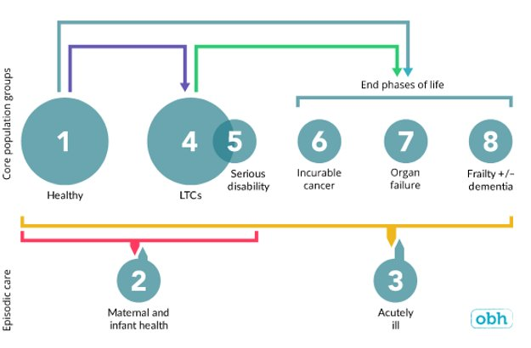
Population Segmentation – Existing Models
Several models exist
They provide parameters/thresholds to segment your population
Relatively easy to implement

Slide 10
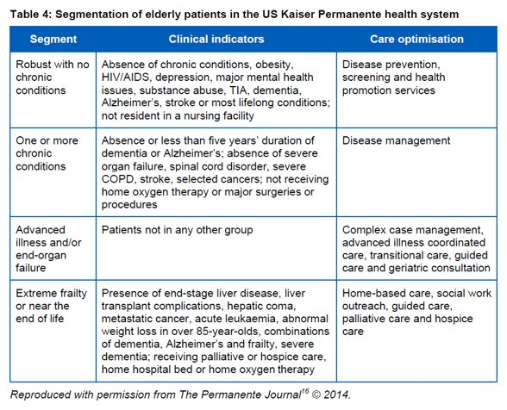
Population Segmentation – Subsegment Approaches
Sometimes we don’t want to look at the entire population, we want to focus on a subset
Many models exist with focus on specific groups, e.g., people with long term conditions or elderly

Slide 11
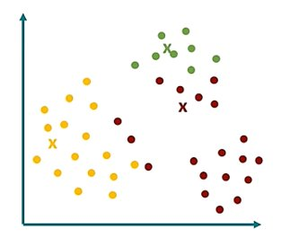
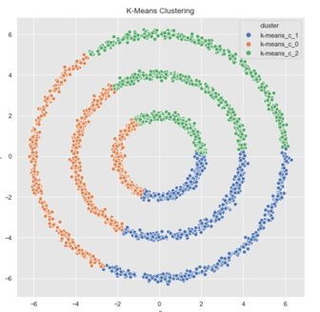
Population Segmentation – Build Your Own Model
If you have the data and the analytical resources, building your own model can be very powerful
Many techniques are available, make sure adequate training has been provided

Slide 12
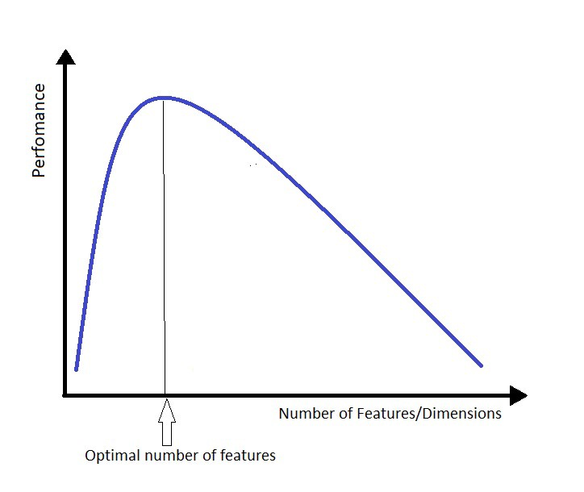
Intermission 1 - The Curse of Dimensionality
Irrelevant attributes do not cancel each other out, they show up as spurious patterns.
Adding more attributes may sound like a good idea, but it often results in worse-performing models
We need to move away from the idea of big data to the idea of correct data

Slide 13
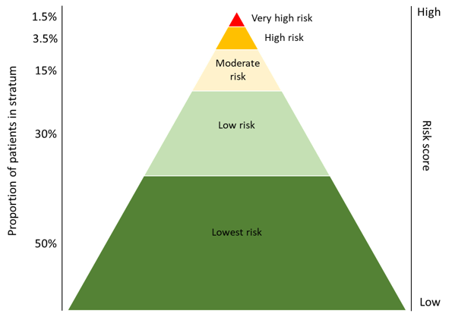
Example Technique – Risk Stratification
The goal of risk stratification is to segment patients into distinct groups of similar complexity and care needs
Risk stratification enables providers to identify the right level of care and services for distinct subgroups of patients
At the individual level, a patient's risk category is the first step towards planning, developing, and implementing a personalised care plan

Slide 14
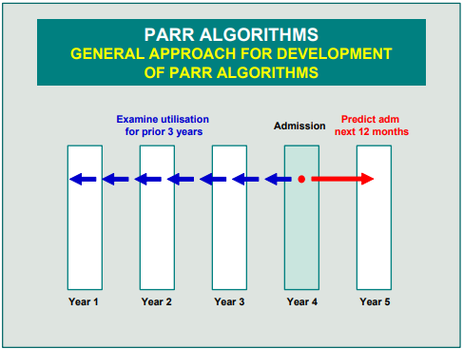
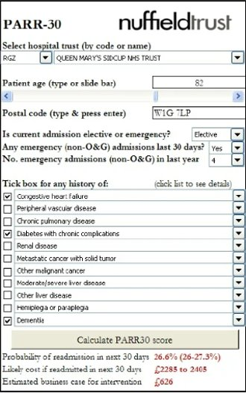
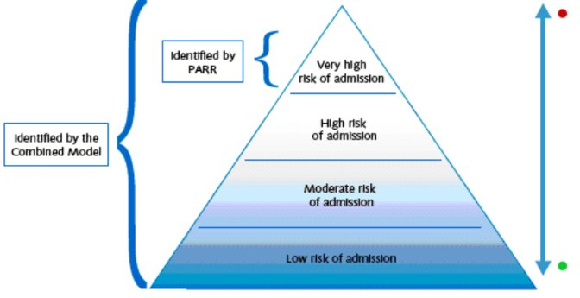
Risk Stratification – Models

Slide 15
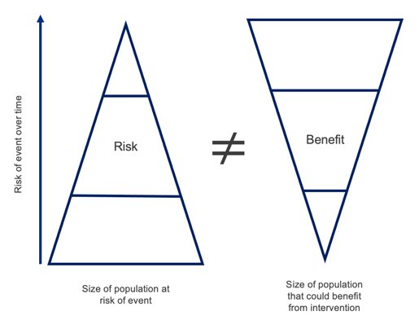
Risk Stratification – We Got This All Wrong
Instinct: to put a lot of resources towards the patients at highest risk
Practice shows this doesn’t work
What’s the missing piece of the puzzle?

Slide 16
Example Technique – Impactibility Modelling
The challenge is to identify which intervention(s) are most likely to succeed for an individual based on their wider circumstances and how those interventions may be delivered in a way that is most likely to achieve a positive outcome

Slide 17
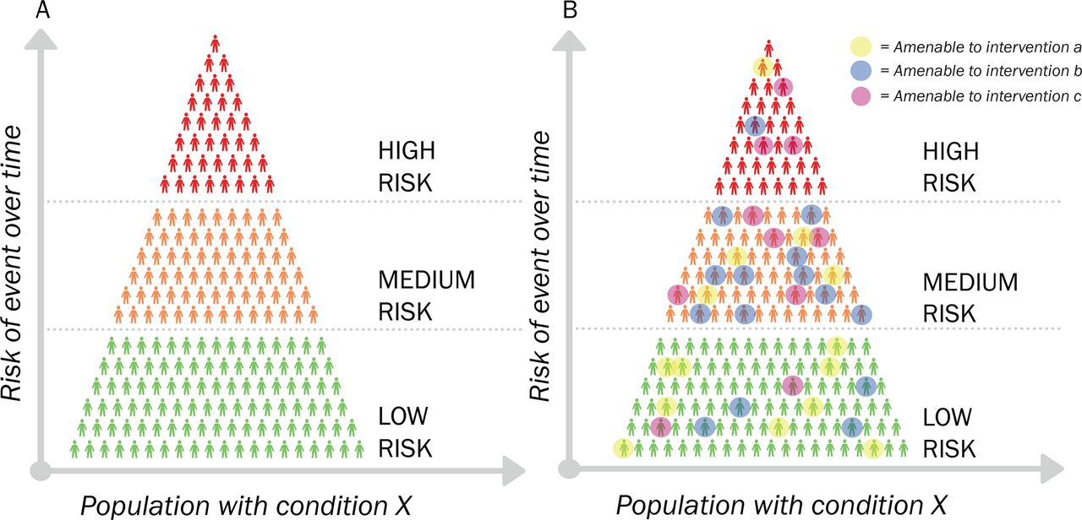
Impactibility Modelling - Definitions
Impactibility is the likelihood that a patient will respond to an intervention and be willing to take part
​Impactibility analysis is a method of evaluating health interventions by measuring patients’ responsiveness to said interventions

Slide 18
Intermission 2 – Universal Proportionalism
Impactibility can be used in different ways depending on the approach to healthcare funding
Proportionate universalism is the resourcing and delivering of universal services at a scale and intensity proportionate to the degree of need
Services are therefore universally available, not only for the most disadvantaged, and are able to respond to the level of presenting need [source: Public Health Scotland]

Slide 19
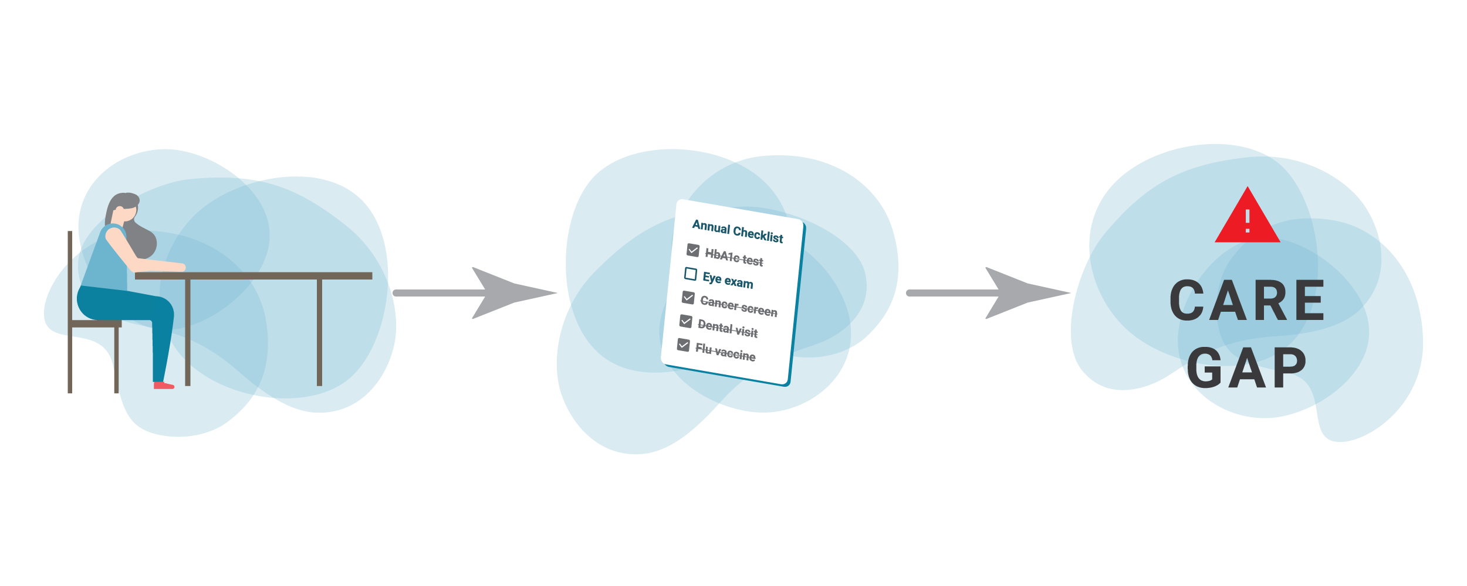
Impactibility Modelling
Approaches to impactibility modelling include:
Health conditions amenable to preventive care
Health needs/gap analysis
Behavioural response models
Propensity to succeed models
HCP’s assessment of an individual’s ‘likelihood to benefit’
Notes:
Lewis G.H. “Impactibility models”: Identifying the subgroup of high-risk patients most amenable to hospital-avoidance programs. Milbank Q. 2010;88(2):240–55.
Lewis G. Next Steps for Risk Stratification in the NHS. NHS England; 2015 Jan.
Hawkins K, Ozminkowski RJ, Mujahid A, Wells TS, Bhattarai GR, Wang S, et al. Propensity to Succeed: Prioritizing Individuals Most Likely to Benefit from Care Coordination. Population Health Management. 2015 Dec;18(6):402–11.
Knabel T, Louwers J. Intervenability: another measure of health risk. By coupling predictive modeling with evidence-based medicine, health plans can identify patients who will benefit the most from care management intervention. Health management technology. 2004 Jan 7;25(7):36,38,39.
Mattie H, Reidy P, Bachtiger P, Lindemeer E, Jouni M, Panch T. A Framework for Predicting Impactability of Healthcare Interventions Using Machine Learning Methods, Administrative Claims, Sociodemographic and App Generated Data. Boston, Massachusetts; 2019.
Freund T, Wensing M, Geissler S, Peters-Klimm F, Mahler C, Boyd CM, et al. Primary care physicians’ experiences with case finding for practice-based care management. Am J Manag Care. 2012 Apr 1;18(4):e155-161.
Population Health Management Flatpack. A guide to starting Population Health Management. NHS England, Public Health England, NHS Digital; 2018 Sep. Report No.: Version 1.0.

Slide 20
Impactibility Has Not Been “Solved" Yet!
Developing good impactibility models is difficult
The Health Economics Unit is active in this area of research!
Research objective: "Understanding which patients with COPD who are most likely to be respond to intervention and in whom outcomes such as acute flare-ups and needing lung surgery can be improved."

Slide 21
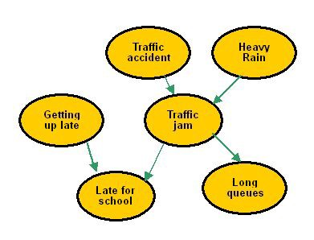
Example Technique: Causal Inference
Data can help us explore cause and effect relationships
This goes beyond correlation and can be used to calibrate our policies
A number of techniques are available and need to be used with care

Slide 22
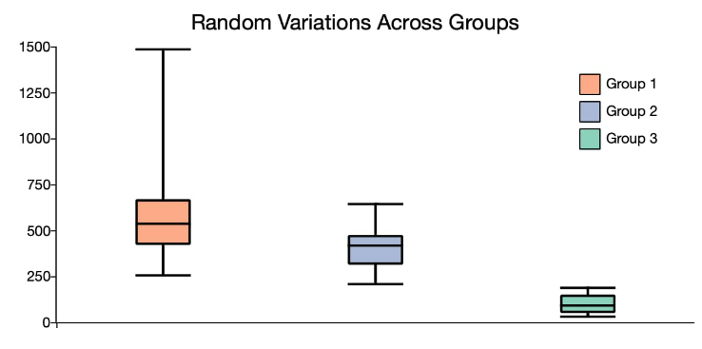
Causal Inference – Example Strategies
Mediator
LoS
Readmission
Confounder
Covariate

Slide 23
I Hope You Enjoyed This Session

