Slide 1
ICS stories: the mental health provider collaborative in Northamptonshire ICS
17 June 2022 at 13:30
Speakers: Paul Sheldon, Morgan Price and Anne Rackham

Slide 2
Mental Health, Learning Disabilities & Autism Collaborative
ICS Conversations

Slide 3
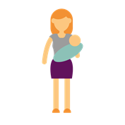
Mental Health, Learning Disabilities & Autism Programme
What are the problems our residents face?
Population Health & Prevention
Outcome-Based Pathways
Acute & Crisis Care
I don’t know when or how to seek help early
I have multiple needs – you have single pathways
My time in hospital needs to be productive
I will die 15-20 years earlier because of my mental health
Services are not culturally sensitive or meaningful to me
I can only talk to you during the daytime
I am at risk of losing my home and my job
I tell my story multiple times, and then give up
Hospitals far away from home mean I don’t see my family
I have experienced adverse childhood events
I exist in the gaps between your pathways
I need to visit
A&E or call an ambulance when you are not there
I feel suicidal and resort to self-harm to cope
I get lost in your system when my needs change or I require transition
My mental health deteriorated during Covid

Slide 4
MHLDA Collaborative Programme
What challenges does our system face?
2,160 adults and
379 children waiting
to access services
People with severe mental health needs are 3x more likely to attend A&E for their physical health
Police colleagues can spend up to four hours in A&E before they are able to admit to S136 suites
At any one time,
10% of NHFTs caseload will have Autistic Spectrum Disorder
2 in every 5 GP appointments are mental health related
We have >4,000 people with an LD, 25% of which need specialist care
Every month there are c.7,708 new referrals for mental health support
LOS for acute admissions can be
up to 54% longer where there is concurrent
depression
Ambulance
response to mental health incidents has risen by >80% since 2018

Slide 5
Mental Health Collaborative Mental Health - Everybody’s concern
Isolated & compartmentalised health & care pathways cause:
When mental, physical, neurodevelopmental and social factors combine in complex and co-occurring ways, professionals can be unsure how best to support, often spending significant time and resource navigating appropriate pathways of care, in the correct sequence. In some cases, only a fragment of the issues are known to the presenting team, which can result in misguided care & treatment plans, and further confusion when these are ineffectual.
Alternatively, it becomes easy to simply treat the condition that the presenting team is expert in, and signpost to support for wider concerns separately. This constitutes a short-term solution, but also fragments the care for the individual and reduces likelihood of achieving population health outcomes. Opportunities to prevent future reliance on health and social care systems are missed. As a result, repeat treatment episodes become necessary, sometimes culminating in frequent/ intensive service users and unnecessary costs to the system. Over time, this has a deleterious affect on the wellbeing and morale of our workforce, as well as their trust in wider pathways of care.
Housing
Physical Health
Debt
Mental Illness
Neurodiversity
Alcohol use
?
?
[Return to Navigation Page]

Slide 6
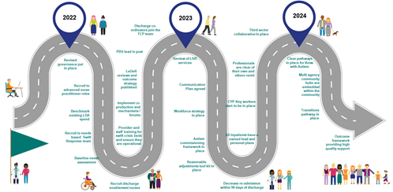
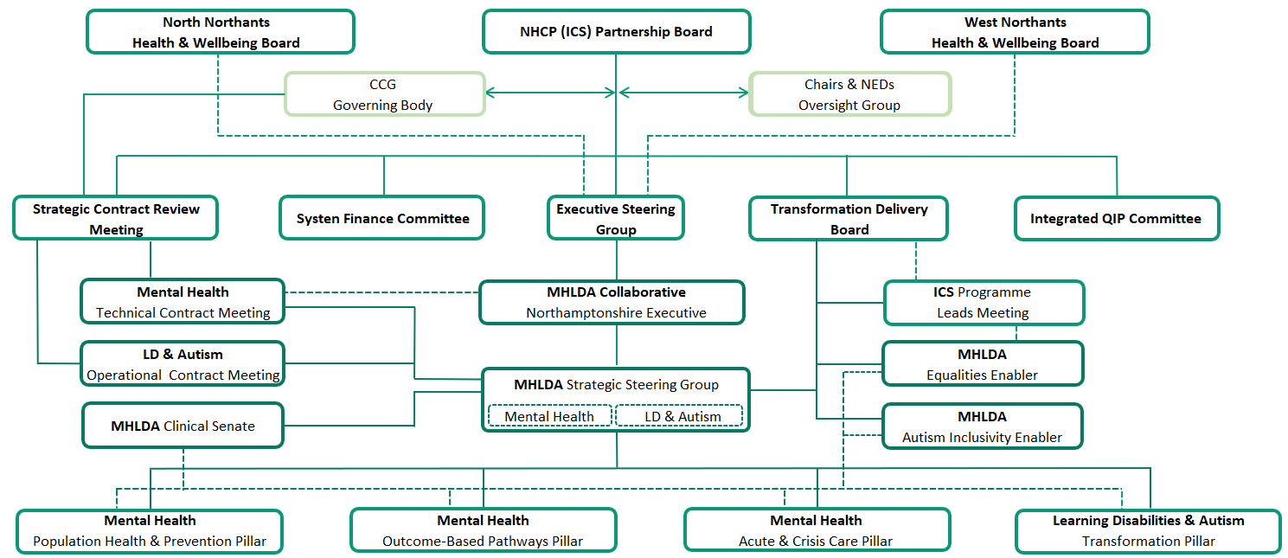
MHLDA Collaborative Programme
Looking Back - Journey
High Level strategic view - Introduction
New Governance Structure
Integrated Planning Team
Co-produced Strategic Roadmap
Our People
Our Data
Our Resources

Slide 7
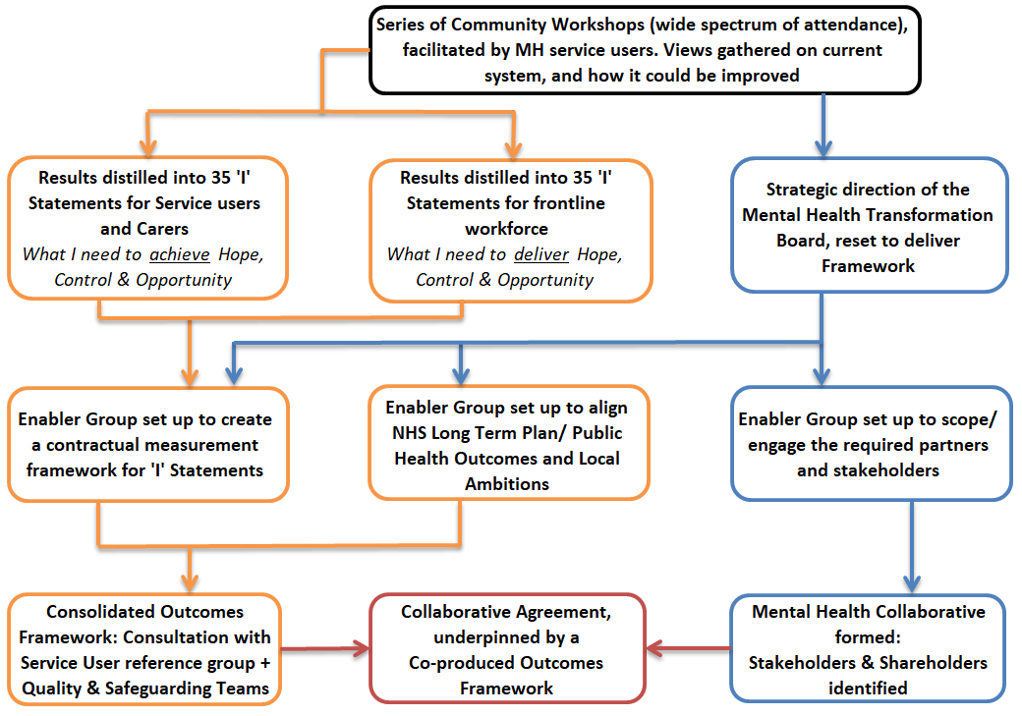
Mental Health, Learning Disabilities & Autism Programme
From 2016 Northamptonshire has developed service user led ‘I’ Statements
Our journey…
Ensuring the voice of lived experience is at the heart of everything we do.
In order to capture the needs and goals of our service users in their own words, we engaged our community in a series of workshops which led to the development of 35 ‘I’ Statements.
These now form the foundation of our Outcomes Framework

Slide 8
Mental Health Collaborative
Examples of our ‘I’ Statements
I have some control over how I access services, when and how the services interact with me and the different treatments available; support is there for me when I feel out of control or unsafe.
I feel the services around me talk to each other and have a joined up approach, reducing the number of times I need to tell my story, they share information in agreement with me to help my journey.
What do our residents want their health and care to look and feel like?
Understanding what our residents want their care to look and feel like has become an integral part of every decision we make, every plan that is considered and the strategic direction ensuring the voice of Lived Experience has equal value around the Collaborative table. Continuously exploring, updating and understanding current experience of all the services we provide and want to provide is evident in our co production work, we surround ourselves by this culture.
This delivers lived experience as an equal voice in strategic development.
I have opportunities to access services that understand me in terms of my history and culture.
I have the right support and it is there for me when I need it; those listening to me know how to access services and have information on what is available including crisis options.
I am given opportunities to develop community networks of support beyond my care team encouraging me to access opportunities enjoy every day activities and to gain new experiences.
I am supported to gain confidence to make my own decisions and maintain control over important aspects of my life, such as finances, budgeting and where I choose to live.
[Return to Navigation Page]
8

Slide 9
MHLDA Collaborative – Northamptonshire
What is the vision?
9

Slide 10
MHLDA Collaborative Programme
Who is our Collaborative, and what do they do?
Experts by Experience
Health & Care Commissioners
Northamptonshire Healthcare Foundation Trust
North & West Unitary Authorities
Mental Health Northants Collaboration
Northamptonshire Police
East Midlands Ambulance Service
Substance to Solutions
Healthwatch
MHLDA Collaborative
NHS Acute Hospital Trusts
GP Federations
Primary Care Networks
Carer Representatives
Public Health Northamptonshire
Giving each partner and sector a clear and equal voice
Checking facts and challenging assumptions
as critical
friends
Generating
new ideas, approaches and solutions using the spectrum of system
resources
Co-designing new, integrated pathways
Combining
data sets,
and sharing
intelligence for
strategic system planning
Combining
resources to
eliminate
duplication
and gaps

Slide 11
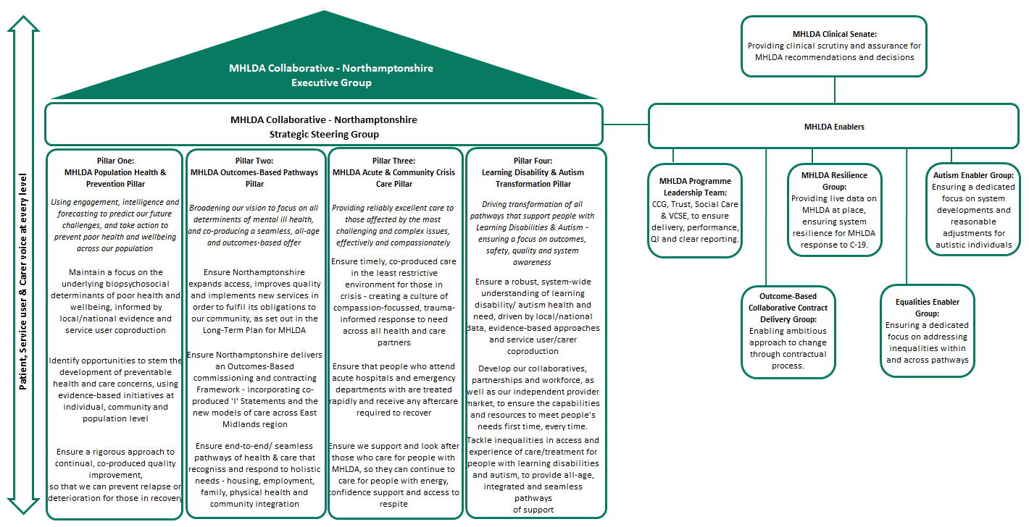
MHLDA Collaborative Programme
How is the programme structured?

Slide 12
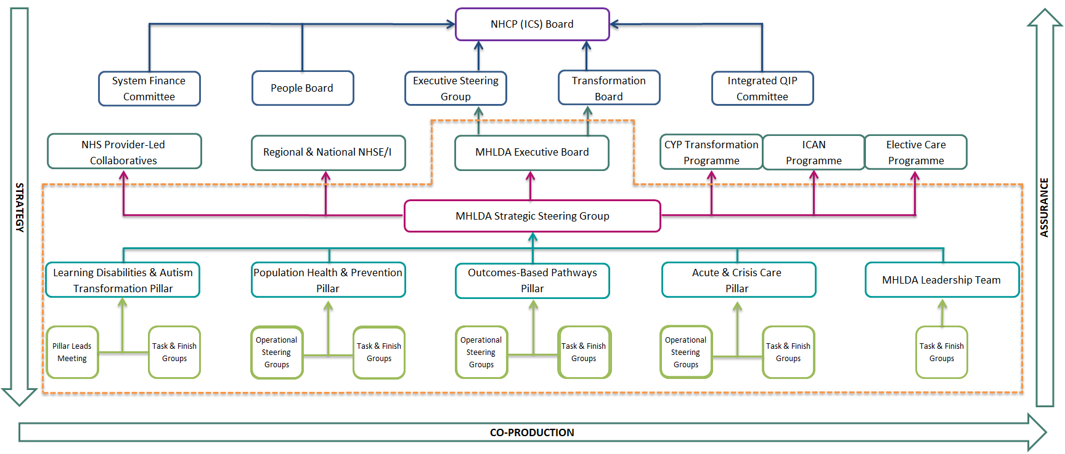
Mental Health Collaborative – Northamptonshire
How is the programme governed?
“Less about Boards and Forums. More about Culture & Ethos”
12

Slide 13
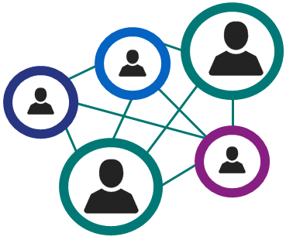
MHLDA Collaborative Programme
Integrated Working between Programmes
1.
2.
3.
4.
Programme recognises a cross-cutting theme with another programme
SRO-to-SRO discussion confirms a Programme Owner.
Agreement over:
Affected pathways
Oversight arrangements
Working Group members
Owner Programme/Pillar convenes Working Group (with cross-programme members if required).
Working Group reports to Pillar/ Programme.
Pillar/Programme provides updates/assurance to related programme via agreed arrangements.

Slide 14
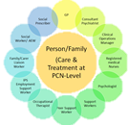
MHLDA Collaborative Programme
Working ‘at place’
Citizen
(Individual – 1 resident)
Provider-led Collaboratives for Secure Care, Eating Disorders and Tier 4 CAMHS inpatient services
Neighbourhood/ Locality
(Primary Care Network - c.30-50,000 residents)
24/7
Integrated
Response
Hub
Digital Support
& Therapy
Pathways
2x MH Inpatient Units
2x Crisis
Houses
Social care Community & Inclusion Hubs
2x Specialist
Treatment
Hubs
Place/ Integrated Care Partnership
(Unitary Authority footprint – c.390,000 residents)
9x
Place-Based CMHTs
MH Crisis
Cafes venues
IPC/PHB
2x Transitions Teams
VCSE Mental Health Hubs
2x Place of Safety
System
(Northamptonshire footprint - c.780,000 residents
MH Police
Triage Car
2x Acute Hospital Liaison
MH Recovery
College
Region
(East Midlands footprint – c.4.8m residents)
MH Ambulance Support in Regional Control Rooms

Slide 15
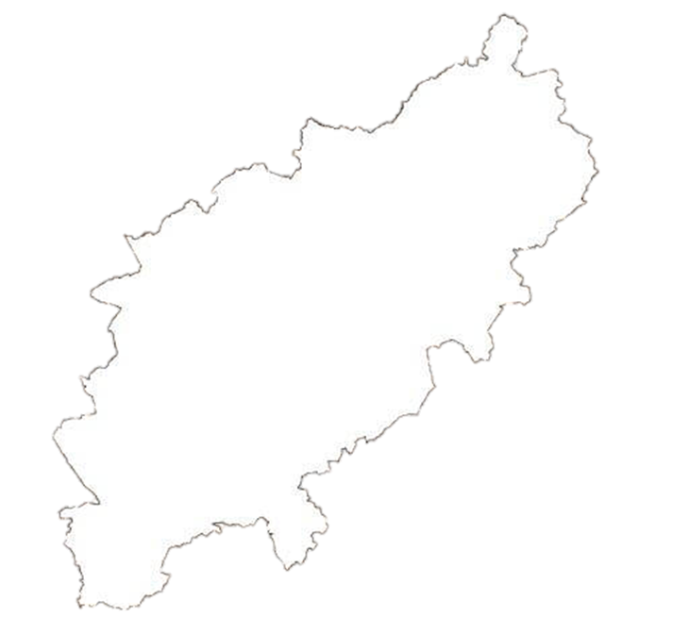
MHLDA Collaborative Programme
Working at ‘Place’ & ‘Sub-Place’
Available at ‘Place’
Mental Health Inpatient Hospitals
Available at ‘Sub-Place’
Specialist Mental Health Treatment Centres
Neighbourhood Community MH Teams
Mental Health Crisis Houses
Mental Health
Crisis Cafes
North Northamptonshire Council – Community Hubs
West Northamptonshire Council – Community Hubs
Mental Health
VCSE Sector Hubs

Slide 16
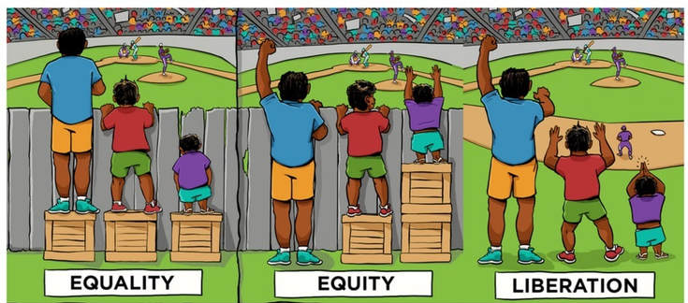
Mental Health Learning Disabilities & Autism Collaborative Programme
Equalities Enabler
Health Equity
Notes:
So as well as introducing the Equalities enabler group , my presentation will touch on why we even need to take action against health inequalities, where the gaps are and really what health equity would look like.
I thought it would be good to quickly set the context by defining the key concepts of equality, equity and health inequalities.
Essentially the enabler group we are discussing here intends to go further than equality to achieve health equity. So what does that look like?
As you can see here , Equality means each individual or group of people is given the same resources or opportunities, and we know that doing the same thing for everybody just doesn’t work.
Equity in contrast recognises that each person has different circumstances and justly allocates the resources and opportunities needed to reach an equal outcome.
In other words Equity is a process and equality is an outcome of that process.
Ultimately we want to get to that liberation state where we dismantle the sources of inequity in the first place
What are health inequalities
Health inequalities are avoidable, unjust and unfair differences in health status and determinants between groups of people due to demographic, socioeconomic, geographical and other factors. These differences determine the risk of people getting ill, their ability to prevent sickness, or opportunities to take action and access treatment when ill health occurs.
Why then do we need to address health inequalities ?
There is clear evidence that reducing health inequalities improves healthy life expectancy and reduces disability across the social gradient.
We are starting from a place where we know that people with severe mental illnesses can expect to die 15-20 years earlier than those without ,
We also know that people with learning disabilities often encounter poorer health outcomes than the general population and are less likely to get checked for some types of cancer for example.

Slide 17
MHLDA Collaborative Programme
Addressing Health Inequalities
Five Key Priorities
Restore Services Inclusively
Core20PLUS – Population Groups
Mitigate against digital exclusion
CORE 20
Most deprived quintile
Core 20 PLUS 5 – Population Groups
Ensure datasets are timely & accurate
Severe Mental Illness
Ensuring annual health checks for 60% of those living with SMI (bringing SMI in line with the success seen in Learning Disabilities
Maternity
Ensuring continuity of care for 75% of women from BAME communities and from the most deprived groups
Chronic Respiratory Disease
A clear focus on Chronic Obstructive Pulmonary Disease (COPD), driving up uptake of Covid, Flu and Pneumonia vaccines to reduce infective exacerbations and emergency hospital admissions.
Early Cancer Diagnosis
75% of cases diagnosed at Stage 1 or 2, by 2028
Hypertension Case-Finding
To allow for interventions to optimise blood pressure and minimise the risk of myocardial infarction and stroke
Accelerate preventative programmes
PLUS 5
Ethnic minorities, etc. Locally determined using PHM data
Leadership & Accountability
17

Slide 18
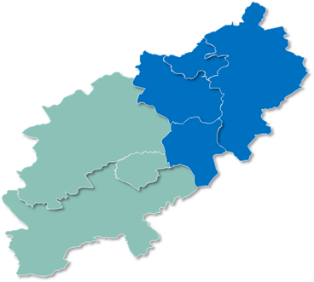
MHLDA Collaborative – Northamptonshire
How do our two ICPs compare?
West Northamptonshire
North Northamptonshire
13% | ⇩ | Mothers who smoke at time of birth | ⇧ | 15%
30% | ⇩ | Year 6 children who are overweight or obese | ⇧ | 34%
14% | ⇨ | Under 16’s who are growing up in low income families | ⇨ | 14%
78% | ⇩ | Adults who are employed | ⇧ | 85%
9% | ⇩ | Households in fuel poverty | ⇧ | 10%
62% | ⇩ | Adults who are overweight or obese | ⇧ | 66%
15% | ⇩ | Adults who smoke | ⇧ | 18%
4 per 100k | ⇨ | Deaths from substance misuse | ⇨ | 4 per 100k
335 per 100k | ⇧ | Emergency hospital admissions for intentional self-harm | ⇩ | 224 per 100K
18

Slide 19
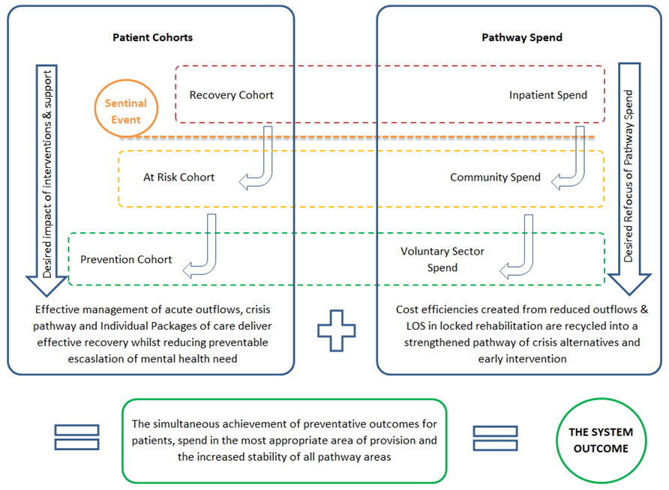
Mental Health, Learning Disabilities & Autism Programme
Investing for Outcomes – Left Shift
The establishment of I statements enabled providers to focus on the shift to prevention, more appropriate pathways that would meet the quadruple aim (better outcomes, better population health, improved work life for our people and to reduce costs).
The collaborative has agreed a set of shared ambitions:
Improve outcomes
Best allocation of limited resources
Focus on longer term transformation
Collaboration not competition
Giving a strategic voice to service users

Slide 20
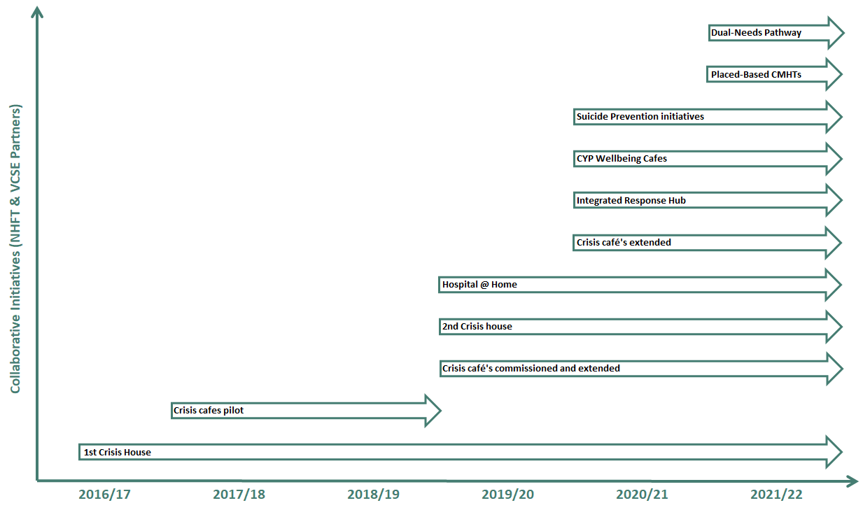
Mental Health, Learning Disabilities & Autism Programme
Delivering integrated care pathways
We started on a collective journey in 2016.
In 2019 NHFT met with the CCG and identified that the best model moving forward was a lead provider collaborative.
This 2019 meeting was supported by VCS Sector, Service Users and Carers

Slide 21
Mental Health Collaborative
Collaborative Contract - Scope of Tranche One
 | Core Adult Mental Health Funding 21/22 (Reported through MHIS)
 | Existing NHFT Block Contract for Adult mental Health | 79,976,074
 | Tranche 1 additions from 1 April 2022 (Existing VCS contracts, Section 12 and NCA) | 1,560,355
 |  | 81,536,429
 | Other Source of Funds 21/22 (Not part of MHIS Reporting)
 | Service Development Review (SDF) - Adults Only | 2,698,000
 | Spending Review (SR) - Adults Only | 2,913,000
 | Total Tranche One plus allocated SDF/SR | 87,147,429
 | Future Tranches to be discussed
 | Continuing Care - Mental Health Package Costs | 2,316,448
 | Adult Mental HRG Tariffs (NGH & KGH) | 4,504,241
 | Package Costs of MH S117 | 2,511,525
 | Individual Packages of Care - M7 Forecast (Nursing/Residential, community/Supported Accommodation) | 9,916,270
 | Total | 106,395,913
 | MHIS spend not currently considered for future tranches
 | Adults other - reported within IPC | 441,023
 | Childrens - reporting at M7 | 12,027,629
 | SMI - part of CCG funding not above | 302,609
 | Prescribing Mental Health Expenditure | 6,263,450
 |  | 19,034,711
 | Total MH spend 2021/22 | 125,430,624
NHFT Contract (Adult MH)
SDF & SR (Adult MH)
VCSE Contract (Adult MH)
Section 12 & NCA Activity
Contract values for 2022-23 onwards would be subject to usual inflation and growth, as well as being committed to the system’s efficiency programme.
Total Tranche One Contract Value:
£87,147,429
[Return to Navigation Page]

